Slide 1
2026
Benefits Enrollment
November 3rd–17th, 2025
Notes:
Welcome to your 2026 Open Enrollment! This is an opportunity to review and make changes to your benefits plan.
Enrollment Period is Open from November 3 to November 17, 2025. Changes you make now will go into effect for the 2026 plan year.

Slide 2
Welcome to your 2026 Open Enrollment!
We offer a competitive and comprehensive benefits program to recognize how important you are to the company.
Annual Open Enrollment November 3- November 17, 2025
Open enrollment is your yearly opportunity to review your current benefits and make changes for the upcoming plan year.
During open enrollment, you can:
Add, change, or decline coverage
Add and/or drop family members
Elect your FSA or HSA amount
This is the only time of year you can make changes to your benefits unless you experience a qualifying life event:
Change of legal marital status
(e.g., marriage, divorce, death of spouse, legal separation)
Change in number of dependents
(e.g., birth, adoption, death of dependent, ineligibility due to age)
Change in employment or job status
You must make changes to your benefits within 30 days of your qualifying life event
2
Notes:
During this open enrollment period, you can add, change, or decline coverage, update family members, and elect FSA or HSA contributions.
After this period, changes can only be made if you have a qualifying life event, such as a change in marital status or number of dependents.

Slide 3
What’s New For 2026
Virta: Weight Loss and Diabetes Reversal
100% covered by AWP
Guided nutrition program—no meds, calorie counting, or extra gym visits
Includes:
Smart scale + blood meter synced to your phone
1:1 health coach support
Medical provider oversight to reduce medications safely
Kaia Health: Virtual Therapy
Support for back, neck, shoulder, knee, hip pain, and more
Personalized digital therapy
Dedicated health coach
Unlimited access for you and dependents—at no cost
Forma will replace Optum Bank for HSA administration
Details to come on account transfer. You will receive a new HSA debit card.
Forma will replace Surency for FSA administration
You will receive a new FSA card
3
Notes:
We’re excited to share updates on two important health programs available to you at no cost.
Virta: Weight Loss and Diabetes Reversal
First, Virta is replacing Real Appeal as our weight management program.
Virta is designed not just for weight loss, but also for diabetes reversal.
It’s 100% covered by AWP, so there’s no cost to you.
“Unlike traditional programs, Virta uses a guided nutrition approach—no medications, no calorie counting, and no extra gym visits required.
“Here’s what’s included:
A smart scale and blood meter that sync to your phone.
1:1 health coach support for personalized guidance.
Medical provider oversight to help reduce medications safely.
Next, Kaia Health provides virtual therapy for musculoskeletal pain—covering back, neck, shoulder, knee, hip pain, and more.
You’ll get personalized digital therapy, a dedicated health coach, and unlimited access for you and your dependents at no cost.
Both programs are fully covered and designed to make it easier for you and your family to stay healthy without extra costs or hassle.
Forma will replace Optum Bank for HSA administration
Details to come on account transfer. You will receive a new HSA debit card
Forma will replace Surency for FSA administration
You will receive a new FSA card
Forma (powered by Peak One) will be the new COBRA vendor

Slide 4
Open Enrollment Process and Resources
ENROLLMENT INSTRUCTIONS
Annual Enrollment to elect benefits for January 1, 2026 is from November 3, 2025 to November 17, 2025
Visit: www.awpsafety.com and refer to your benefit guide to view plan details and rates.
Enroll through UKG and follow UKG Open Enrollment Instructions for all annual open enrollment elections.
This is a passive enrollment, meaning your current elections will rollover except for the FSA and HSA. The FSA & HSA requires that you re-enroll for the January 1, 2026 plan year..
4
Notes:
Complete your elections through UKG and refer to the Benefit Guide for specific details. This is a passive Enrollment: Current elections will roll over, but remember to re-elect for FSA and HSA contributions.

Slide 5
Meet Our 2026 Vendor Partners!
Benefit | Vendor Partner
Medical and Prescription | United Healthcare
Medical and Prescription | Kaiser - Hawaii and California Team Members
Dental | Delta Dental
Vision | United Healthcare
Flexible Spending Account (FSA) | Forma
Health Savings Account (HSA) | Forma
Life and AD&D | Lincoln Financial
Disability Insurance | Lincoln Financial
Accident, Hospital Indemnity & Critical Illness | Lincoln Financial
Legal and ID | LegalShield / IDShield
Employee Assistance Program | ComPsych
Benefits Helpline | Lockton
5
Notes:
Here is a review of your vendor partners for 2026. The only vendor change for 2026 is the administrator of the health savings account and flexible spending account

Slide 6

Medical and Prescription Benefits UHC & Surest

Slide 7






Health Insurance Terms to Know
Premium
The amount you pay for your health insurance every month
Deductible
The amount you pay out of pocket for health care before your insurance starts to help out
Coinsurance
The percentage you pay for the cost of covered health care services, after you meet your deductible
Copay
A fixed payment for a covered service
Out-of-pocket maximum
Is a “cap” on your costs for the year; it is the most you’ll pay for in-network health care services
Network
A group of doctors, labs, hospitals & other providers that your plan contracts with at a set payment rate
Notes:
Before we discuss your benefit plans, let’s briefly review some important insurance terms.
Premium is the amount you pay pre-tax out of your paycheck each pay period.
Deductible is the amount of money you are responsible for paying up-front before your plan shares your costs.
Coinsurance is the percentage that you and the plan pay. In our plans, your coinsurance is much smaller than the plan’s coinsurance.
Copay is a fixed amount for certain services that you pay in some of our plans.
Out of pocket maximum is the limit on your expenses. Once you reach this limit, the plan covers all eligible expenses for the remainder of the plan year.
Network is the providers and facilities that have agreed to partner with our company and offer you our discounted rates.

Slide 8

Medical and RX Coverage | PPO $1,500
Medical Benefits | In- Network | Non-Network
Deductible
Individual | $1,500 | $4,000
Family | $4,500 | $8,000
Coinsurance | 80% | 60%
Maximum Out of Pocket
Individual | $5,000 | $8,000
Family | $10,000 | $16,000
Preventive Care | No Cost | Ded+40%
Office Visits
Primary Care | $30 Copay | Ded+40%
Specialists | $50 Copay | Ded+40%
Hospital Care
Inpatient Coverage | Ded+20% | Ded+40%
Outpatient Surgery | Ded+20% | Ded+40%
Mental Health Services
Inpatient | Ded+20% | Ded+40%
Office Visits | $30 Copay | Ded+40%
Emergency Room | $300 Copay | $300 Copay
Urgent Care | $100 Copay | Ded+40%
Prescription Drug | In-Network | Non-Network
Deductible | NA | NA
Retail
Tier 1 | $10 Copay | Ded+50%
Tier 2 | $35 Copay | Ded+50%
Tier 3 | $70 Copay | Ded+50%
Tier 4 | 20% up to $200 | Ded+50%
Mail Order
Tier 1 | $25 Copay | Not Covered
Tier 2 | $85 Copay | Not Covered
Tier 3 | $175 Copay | Not Covered
Tier 4 | 20% up to $500 | Not Covered
This plan is compatible with a Healthcare Flexible Spending Account (FSA)!
8
Notes:
You have access to 2 medical plans through UnitedHealthcare. Selecting a plan option to meet the needs of you and your family depends on a variety of factors such as your health care budget, the types of ongoing treatment, medical services and any elective procedures you or your family may need in the upcoming year.
Before we dive into each plan option lets talk through what’s the same with all your medical plans. The deductible and out of pocket maximum on all plans will restart January 1, 2026. All plans cover preventive care services like annual physicals, well-woman exams and well-child visits at 100% if you use a provider who’s in-Network. You have access to out of network benefits, but for this presentation we will only focus on in-network benefits.
You’ll want to consider participating in different tax advantaged plans like the Healthcare flexible spending account and the Health Savings Account, depending on your medical plan election.
Now let’s review your first plan option which is the PPO $1,500 , on this plan you have a $1,500 deductible for individual and a $4,500 deductible for family. The coinsurance level is 80%. The out of pocket maximum is $5,000 for individuals and $10,000 for families. All services count towards your out-of-pocket maximum. After you reach your out-of-pocket maximum all services are covered 100%.
Your deductible will only apply first for any hospital care like inpatient coverage or outpatient surgery along with inpatient mental health services. For these services after you meet the plan deductible you’ll pay the 20% coinsurance and the plan will pay the rest.
For office visits, the emergency room and urgent care you have a flat copay. For primary care visits you have a $30 copay and for specialists you have a $50 copay. Emergency room is a $300 copay and the urgent care is a $100 copay.
The prescription drug program has 4 tiers. Tier 1 drugs are a $10 copay. Tier 2 drugs are a $35 copay. Tier 3 drugs are a $70 copay. Tier 4 drugs you pay 20% up to $200

Slide 9
Medical and RX Coverage | HSA $3,400
Medical Benefits | In- Network | Non-Network
Deductible
Individual | $3,400 | $3,400
Family | $6,800 | $6,800
Coinsurance | 90% | 60%
Maximum Out of Pocket
Individual | $7,050 | $10,000
Family | $14,100 | $20,000
Preventive Care | No Cost | Ded+40%
Office Visits
Primary Care | Ded+10% | Ded+40%
Specialists | Ded+10% | Ded+40%
Hospital Care
Inpatient Coverage | Ded+10% | Ded+40%
Outpatient Surgery | Ded+10% | Ded+40%
Mental Health Services
Inpatient | Ded+10% | Ded+40%
Office Visits | Ded+10% | Ded+40%
Emergency Room | Ded+10% | Ded+0%
Urgent Care | Ded+10% | Ded+40%
Prescription Drug | In-Network | Non-Network
Deductible | Combined with Medical | Combined with Medical
Retail
Tier 1 | $10 Copay | Ded+40%
Tier 2 | $35 Copay | Ded+40%
Tier 3 | $60 Copay | Ded+40%
Tier 4 | 20% up o $200 | Ded+40%
Mail Order
Tier 1 | $25 Copay | Not Covered
Tier 2 | $85 Copay | Not Covered
Tier 3 | $150 Copay | Not Covered
Tier 4 | 20% up to $500 | Not Covered
This plan is compatible with a Health Savings Account (HSA)!
9
Notes:
Your second plan option is the HSA $3,400 plan. This is a High Deductible Health plan which allows you to open a tax advantaged Health Savings Account., or HSA. We’ll review what an HSA is in more detail later on along with the benefits of contributing tor Health Savings Account compatible plan. This plan has a $3,400 deductible for individual deductible and a $6,800 family deductible. On this plan your deductible applies first to all services including office visits, hospital, emergency room , and prescription drugs. After you meet your plan deductible all services, except for pharmacy are covered 100% by the plan. For your prescription drug coverage after you meet the plan deductible you will pay a copay until you reach your plan out of pocket maximum. The out of pocket maximum is $7,050 for individuals and $14,100 for families.

Slide 10
UnitedHealthcare Resources
Get the most out of your benefits
When your plan year begins, you and your covered dependents will receive health plan ID cards, which contain your Member ID number, Group Number and important information for your pharmacy. Your UHC Group Number is 929408.
When your ID card arrives you can:
New members register for your personalized website on myuhc.com® and download the UnitedHealthcare® app.
These digital tools are designed to help you understand your benefits and make informed decisions about your care.
Find care and compare costs for providers and services in your network
Check your plan balances, view your claims and access your health plan ID card
Access wellness programs and view clinical recommendations
24/7 Virtual Visits – Connect with providers by phone or video* to discuss common medical conditions and get prescriptions,*,* if needed
Compare prescription costs and order refills
10
Notes:
You and your covered dependents will receive new ID cards for the 2026 plan year. They will arrive in a plain white envelope. Please replace your current ID card with the new one.

Slide 11


UnitedHealthcare Resources
How to find a doctor
Search for in-network providers and pharmacies under the Choice Plus Network using the UnitedHealthcare mobile app or on myuhc.com:
Doctors, hospitals, labs, and other healthcare providers in your area.
Details about doctors, including educational background, languages spoken, and patient reviews.
Cost comparisons for treatments and services.
11
Notes:
It is easy to find doctors and healthcare professionals in your plan by visiting myuhc.com or using the UnitedHealthcare mobile app and choosing the Choice Plus network.
You can also find patient reviews, cost comparisons for treatments and doctor details.

Slide 12

Virtual Care
With UnitedHealthcare’s virtual care, it’s easy to video chat with your doctor 24/7—whenever, wherever!
Connect with care anywhere
Telehealth appointments on your mobile phone, tablet, or computer with a camera.
Board-certified doctors are available 24/7 for advice, treatment, and prescriptions.
See a licensed therapist or psychiatrist. Appointments are available 7 days a week and usually cost the same as an in-person visit.
It costs less than or equal to an in-person office visit.
12
Notes:
Your plan comes with a virtual care option so you can see a doctor or therapist using your smartphone, tablet, or computer with a camera. With your virtual care option through UnitedHealthcare, you can:
Have 24/7 access to doctors in about 10 minutes or less. The doctors can assess your condition and send prescriptions to your pharmacy, if needed. It's a great choice when your doctor isn't available for things like pinkeye, the flu, a cold, a sinus infection and more.

Slide 13

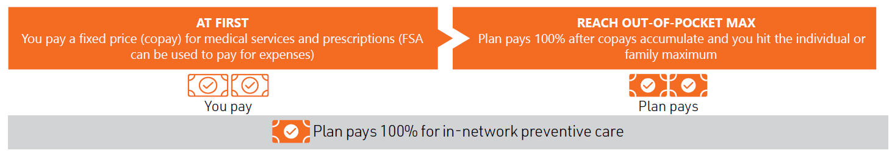
Surest PPO Plan
With this plan, there’s no deductible or coinsurance. Instead, all your healthcare purchases have a fixed price (copay) for your out-of-pocket costs. So you know the cost of your treatment options before you go to the doctor. If you enroll in this option, you can enroll in a Health Care Flexible Spending Account.
This plan accesses the same UHC Choice Plus Network and Advantage Formulary list as your current UHC plans.
Surest Highlights
No deductible, no coinsurance
Copay price based on service and provider selection
Upfront pricing (you know what you owe in advance)
Easily search your symptoms within Surest app* or website
Opportunities to pay less for quality care
Notes:
The Surest plan has no deductible or coinsurance. Instead, there’s an Out-of-Pocket Maximum, which serves as your safety net. For in-network, it’s $8,000 for individuals and $16,000 for families.
What’s great about Surest is that it offers upfront pricing, which you can view via their app or website, allowing you to see exactly what you’ll pay before receiving care. This includes standard labs, x-rays, ultrasounds, and vaccinations.
You and your covered dependents will receive new ID cards for the 2026 plan year. They will arrive in a plain white envelope. Please replace your current ID card with the new one.

Slide 14

The Surest Plan In A Nutshell
The Surest app and website let you:
Search for care by symptom, location, or provider
See upfront prices and what’s included in a visit
Compare alternative treatment options, including virtual care at no or low copay
View your claims activity (EOBs)
Access your digital ID card
Notes:
The Surest app and website lets you:
Search for care by symptom, location, or provider
See upfront prices and what’s included in a visit
Compare alternative treatment options, including virtual care at no or low copay
View your claims activity (EOBs)
Access your digital ID card

Slide 15
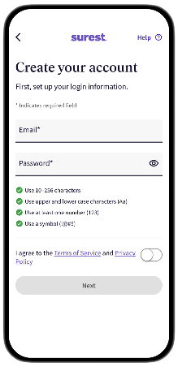






Surest App & Website
Create your account
Download the free Surest app
Create your account
Join.Surest.com is your pre-member site.
Benefits.Surest.com is where you go once you become a member.
surest.com
Notes:
Create your Surest account by visiting the website or by downloading the Surest app.

Slide 16
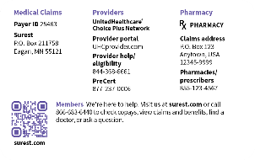
At Your First Visit, Have Your Digital Or Physical ID Card
Surest is a UnitedHealthcare company, but it’s not UnitedHealthcare. Some providers may not be as familiar with the Surest name. If you have trouble checking in, Surest Member Services can help!
Remind the office that the Surest health plan uses the UnitedHealthcare network of providers, clinics, and hospitals
Show the back of your card to share network and provider information
Ask staff to confirm eligibility through UHCprovider.com call or 844-368-6661
Many surgeries and some procedures require a prior authorization
A network provider or facility should initiate your prior authorization on your behalf* at least 15 days prior to the procedure. This is our standard processing time for these requests.
If you have an upcoming procedure and are unsure whether a prior authorization is required, consult with your provider’s office or call Surest Member Services for guidance at 866-683-6440.
Your provider can contact the Surest Medical Prior Authorization line at
877-237-0006.
*If you see an out-of-network provider, you are responsible for obtaining the prior authorization. However, your provider may still be willing to submit the prior authorization on your behalf. Please call Surest Member Services for guidance.
Notes:
At your first visit, have your ID card ready.
Surest is a UnitedHealthcare company, but it’s not UnitedHealthcare. Some providers may not be as familiar with the Surest name. If you have trouble checking in, Surest Member Services can help!
Remind the office that the Surest health plan uses the UnitedHealthcare network of providers, clinics, and hospitals
Show the back of your card to share network and provider information
Ask staff to confirm eligibility through UHCprovider.com call or 844-368-6661

Slide 17


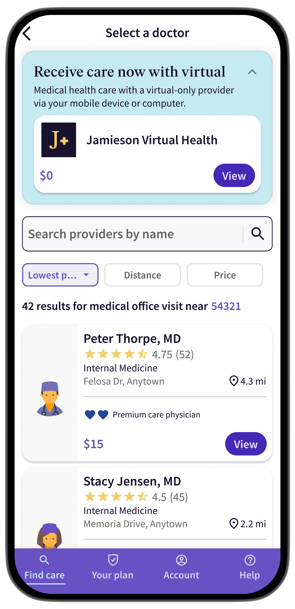
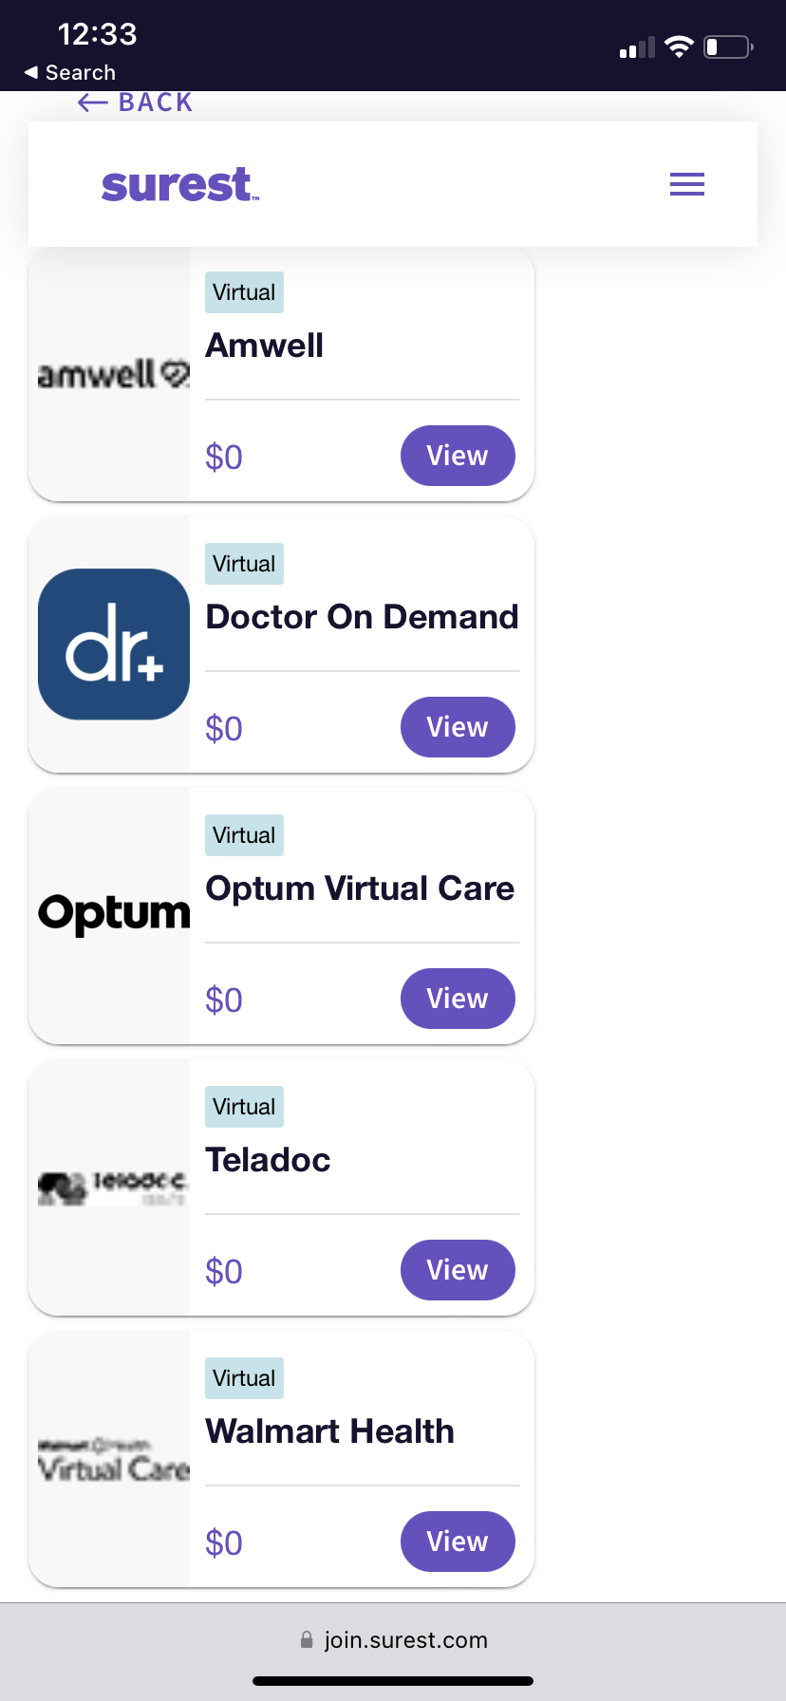
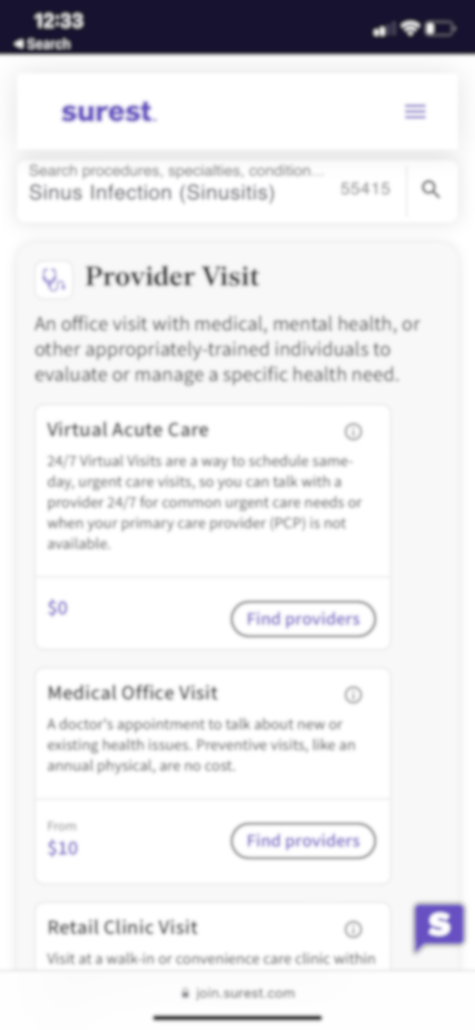
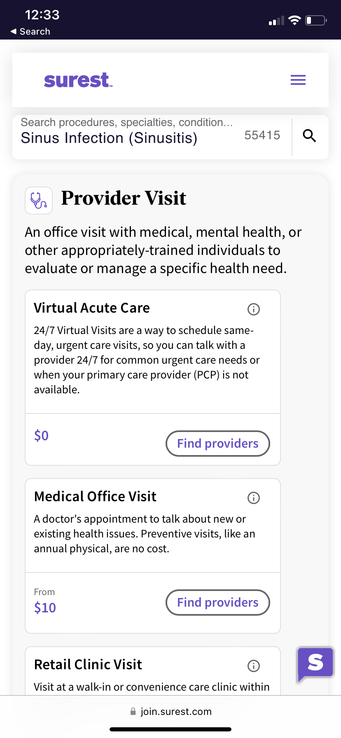
Surest Has Expanded Virtual Care
Three easy ways to find virtual care:
The Surest health plan has expanded virtual care coverage.
1
2
3
Search in the app or website for a condition, provider, or treatment and see an option for Virtual Care. It’s part of the search experience.
For added awareness, you’ll see virtual alternatives when selecting “in-person medical office visit”.
And—when you select virtual care —you'll be able to see the virtual care providers available to you.
Virtual primary care
Virtual urgent and acute care
Virtual mental and behavioral health
Virtual serious mental illness
Virtual intensive outpatient therapy
Virtual substance use support
Virtual eating disorder support
Virtual exercise therapy
Virtual gastroenterology
Virtual speech therapy
Virtual migraine clinic
Convenient: Often same-day appointments
Accessible: No driving to a clinic. See a medical professional from the comfort of home (or wherever you are).
Low (or no) cost: Virtual care is often low- or no-cost. Don’t skip necessary medical care because of unknown costs.
Designed to be easy to use: Virtual care is part of your Surest plan.
Notes:
Expanded Virtual Care Options with Surest:
Surest offers a variety of virtual care services, providing easy access to medical professionals from the comfort of your home.
Cost-Effective and Convenient:
Many virtual care services are available at low or no cost, helping to reduce out-of-pocket expenses.
Same-day appointments are available for quick access to care, including primary care, urgent care, and mental health services.
How to Access:
Use the Surest app or website to explore virtual care options.
Book appointments directly through the platform and receive care without having to visit a physical office.
Telemedicine for Routine and Specialty Care:
Virtual care isn't just for urgent needs. You can also access routine consultations and specialist appointments virtually.
No Deductible or Coinsurance:
Virtual care under Surest comes with no deductible or coinsurance, making it an affordable option for everyday health needs.

Slide 18
Medical and RX Coverage | Surest PPO Plan – UHC Choice Plus Network
Medical Benefits | In- Network | Non-Network
Deductible
Individual | $0 | $0
Family | $0 | $0
Coinsurance | Not applicable no coinsurance
Maximum Out of Pocket
Individual | $8,000 | $16,000
Family | $16,000 | $32,000
Preventive Care | No Cost | $215
Virtual Care
Primary and Urgent | $0 | Not Covered
Mental Health & Substance Use | $50 - $100 | Not Covered
Office Visits
Primary Care | $50-$160 | $215
Specialists | $50-$160 | $215
Hospital Care
Inpatient Coverage | $80-$5,500 | Up to $13,000
Outpatient Surgery | $80-$5,500 | Up to $13,000
Mental Health Services
Inpatient | $4,500 | $13,000
Office Visits | $50 | $215
Emergency Room | $1,000 | $1,000
Urgent Care | $110 | $200
Prescription Drug | In-Network | Non-Network
Retail 30 Days Supply
Tier 1 | $10 | Not Covered
Tier 2 | $90 | Not Covered
Tier 3 | $200 | Not Covered
Tier 4 | $550-$650 | Not Covered
Retail 90 Days Supply
Tier 1 | $25 | Not Covered
Tier 2 | $225 | Not Covered
Tier 3 | $500 | Not Covered
Tier 4 | N/A | Not Covered
If you elect this plan, you will receive an ID card and access benefit information through the Surest app or visit Benefits.Surest.com
18
Notes:
With the Surest Medical plan offering there is no Deductible or Coinsurance:
You pay fixed copays for services right from the start, with no deductible to meet first.
You will have upfront, transparent pricing:
Make sure to use the Surest app or website to see the cost of services before you receive care.
Using the app or website allows you to easily compare prices for doctors, treatments, and procedures.
The Out-of-Pocket Maximums are as follows and acts like a safety net for larger expenses:
$8,000 for individuals (in-network).
$16,000 for families (in-network).
You have access to Nationwide Network with UnitedHealthcare Choice Plus network of providers.
Surest provides comprehensive coverage and covers routine care like labs, x-rays, ultrasounds, and vaccinations.

Slide 19

Your Pharmacy Benefits PPO $1,500 | HDHP $3,400 | Surest
Your plan covers:
Medicines on the Advantage Formulary List, including brand-name and generic drugs.
Certain preventive drugs at little or no cost to you.
Most specialty drugs if you have an ongoing health issue or serious illness.
If you have a prescription that is not covered, talk to your doctor or pharmacist about:
Finding another drug.
Switching to a generic or over-the-counter drug.
19
Notes:
Let’s talk about prescription coverage. Your plan covers a lot of medicines, but you can always check the drug lists on the Advantage formulary for your prescriptions — the brand-name drugs and the generics — to be sure they’re included in your plan at a price that works for you.
You can also use the Medication Search tool on our website to check drug prices with certain plans.

Slide 20
Medical and Prescription Benefits Kaiser – CA & HI

Slide 21

Medical and RX Coverage Kaiser – California Team Members
Medical Benefits
Deductible
Individual | $1,000
Family | $2,000
Coinsurance | 20%
Maximum Out of Pocket
Individual | $3,800
Family | $7,600
Preventive Care | No Cost
Office Visits
Primary Care | $20
Specialists | $30
Hospital Care
Inpatient Coverage | 20% after deductible
Outpatient Surgery | 20% after deductible
Emergency Room | 20% after deductible
Urgent Care | $30 copay
Prescription Drug
Deductible | Combined with Medical
Retail
Tier 1 | $10
Tier 2 | $30
Tier 3 | $60
Tier 4 | 20% up to $250
This plan is compatible with a Healthcare Flexible Spending Account (FSA).
Notes:
For California team members, you have medical and Rx coverage through Kaiser. For 2026 the deductible is increasing to $1,000 for individual and $2,000 for family. You pay a flat dolor copay for services and prescriptions. Those copays apply to your maximum out of pocket which is increasing to $3,800 for individuals and $7,600 for family.
Please also note emergency room now falls under deductible and coinsurance.

Slide 22
Medical and RX Coverage Kaiser – Hawaii Team Members
Medical Benefits
Deductible
Individual | $0
Family | $0
Coinsurance | 20%
Maximum Out of Pocket
Individual | $2,500
Family | $7,500
Preventive Care | No Cost
Office Visits
Primary Care | $15 copay (17+); $0 copay (through age 17)
Specialists | $15
Hospital Care
Inpatient Coverage | 20%
Outpatient Surgery | 20%
Emergency Room | 20%
Urgent Care | $15
Prescription Drug
Deductible | Combined with Medical
Retail
Tier 1 | $10 copay ($3 OTC)
Tier 2 | $45 copay
Tier 3 | $200 copay
This plan is compatible with a Healthcare Flexible Spending Account (FSA).
Notes:
For Hawaii team members, you have medical and Rx coverage through Kaiser. The plan does have a $0 deductible for individual and $0 deductible for family. You pay a flat dolor copay for services and prescriptions. Those copays apply to your maximum out of pocket which is $2,500 for individuals and $7,500 for family.

Slide 23
Medical and RX Coverage Kaiser (Buy-Up)– Hawaii Team Members
Medical Benefits | In- Network Tier 1 | Contracted Network Tier 2 Non-Network Tier 3
Deductible
Individual | $0 | $100
Family | $0 | $300
Coinsurance | 20% 20%
Maximum Out of Pocket
Individual | $2,000 | $2,000
Family | $6,000 | $6,000
Preventive Care | No Cost | No Cost
Office Visits
Primary Care | $20 | Coins/Deductible
Specialists | $20 | Coins/Deductible
Hospital Care
Inpatient Coverage | 10% | 20%
Outpatient Surgery | 10% | 20%
Emergency Room | $100 | $100
Urgent Care | $15 | $15
Prescription Drug
Deductible | Combined with Medical
Retail
Tier 1 | $10 copay ($3 OTC)
Tier 2 | $45 copay
Tier 3 | $200 copay
This plan is compatible with a Healthcare Flexible Spending Account (FSA).
Notes:
For Hawaii team members we’re excited to offer a new Kaiser Permanente buy-up option for 2026. This plan provides enhanced flexibility, allowing you to access care both within and outside the Kaiser Permanente network. The buy-up plan gives you more provider choice while still offering the coordinated, high-quality care Kaiser Permanente is known for. You can choose from three tiers of care—Kaiser providers, participating / contracted network providers and nonparticipating providers—depending on your needs and preferences.

Slide 24

Savings and Spending Accounts

Slide 25

Health Savings Account Overview
Your health care debit card!
Reimburse yourself from your HSA at any time
Funded through pre-tax payroll deductions
Triple tax benefit
Deposit tax-free
Spend funds tax-free
Earn interest tax-free
Funds roll over
Funds always belong to you
Must be used for eligible expenses
Coverage | IRS Annual Maximum
Individual Coverage | $4,400
Family Coverage | $8,750
Age 55 or older | Contribute + $1,000
Notes:
An HSA is a personal bank account you can use to pay for your family’s healthcare costs. An HSA is like a checking account; you must have money in the account in order to use it.
As long as you have funds in the account you can simply pay for qualified services with your HSA card.
If you don’t have funds in your HSA and must pay out-of-pocket with cash or another bank account you can reimburse yourself from the HSA at a later date when the funds are available.
You can elect to make contributions to an HSA from your paycheck. Your HSA contributions will be deducted tax-free, and deposited into your HSA account. This means you will pay less tax on the money you take home while also paying for healthcare expenses tax free through your HSA.
You will need to reelect the amount you want to put into your HSA account each year since elections do not rollover.
HSAs are considered a triple tax benefit in that you save money into the account tax free and spend it tax free. Additionally, after you’ve earned a certain level of funding in the account your dollars can begin earning interest tax free too!
There is no “use it or lose it” penalty with HSAs; at the end of the year your remaining balance will roll over into the next plan year.
Your HSA is also portable; if you change jobs or health plans the money goes with you. You own the account and the funds within it just like any other bank account.
Remember though, the HSA is designed to pay for qualified healthcare expenses. You may be penalized or taxed for using your HSA dollars to pay for ineligible expenses. Keep receipts of qualified expenses for your records.

Slide 26
Health Savings Account (HSA)
A health savings account (HSA) is a tax-favored personal savings account which works with your high deductible health plan.
HSA dollars can be used to pay for qualified medical expenses such as deductibles, copays, dental, and vision care.
HSA Benefits
Tax Savings
Funds always belong to you
Funds always roll over from year to year
Lowers your taxable income
Helps you build a healthcare nest egg for emergencies or retirement
Tax deduction when you contribute
Tax-free earnings through investment
Lowers your taxable income
Tax-free withdrawal for qualified expenses
Coverage | IRS Annual Maximum
Individual Coverage | $4,400
Family Coverage | $8,750
Age 55 or older | Contribute + $1,000
26
For a complete list of qualified medical expenses visit www.irs.gov in IRS Publication 502.
Notes:
If you enroll in one of HDHP’s you have the option to open a tax advantaged Health Savings Account (HSA). The HSA account is an optional savings account used to pay for qualified medical expenses. An HSA is a personal bank account you can use to pay for your family’s healthcare costs. An HSA is like a checking account; you must have money in the account in order to use it.
As long as you have funds in the account you can simply pay for qualified services with your HSA card. If you don’t have funds in your HSA and must pay out-of-pocket with cash or another bank account you can reimburse yourself from the HSA at a later date when the funds are available.
You can elect to make contributions to an HSA from your paycheck. Your HSA contributions will be deducted tax-free, and deposited into your HSA account. This means you will pay less tax on the money you take home while also paying for healthcare expenses tax free through your HSA.
You will need to reelect the amount you want to put into your HSA account each year since elections do not rollover. Please note if you are currently enrolled in a Flexible Spending account (FSA) you must have a $0 balance to contribute to the HSA starting January 1, 2026.
You may use your debit card or submit your expenses to reimburse yourself.
You can contribute to an HSA only if you are enrolled in a high deductible health plan and you are not covered by another medical plan or flexible spending account except for the limited purpose flexible spending account, which we’ll discuss in a moment.
If at any point you change medical plans and you are no longer enrolled in the HDHP, you can no longer contribute to your HSA. However, you can still use the funds within your HSA to pay for qualified medical expenses.
Did you know you get a triple tax advantage with an HSA? Here’s how:
1 - The contributions you make to your HSA are made through payroll deduction on a before-tax basis
2 - The money in your account (including interest and investment earnings) grows tax-free
3 - Funds are withdrawn tax-free to pay for qualified medical expenses
More great benefits to an HSA:
There is no “use it or lose it” penalty with HSAs; at the end of the year your remaining balance will roll over into the next plan year.
Your HSA is also portable; if you change jobs or health plans the money goes with you. You own the account and the funds within it just like any other bank account.
Remember though, the HSA is designed to pay for qualified healthcare expenses. You may be penalized or taxed for using your HSA dollars to pay for ineligible expenses. Keep receipts of qualified expenses for your records
Here's an important note if you are nearing Medicare enrollment age. You cannot contribute to an HSA if you are enrolled in any part of Medicare. Therefore, you may want to postpone enrolling. Be sure to contact your local Social Security Office to discuss your options and eligibility since delaying Medicare enrollment can incur penalties.

Slide 27

HSA Eligibility
You are eligible to open and contribute to an HSA if you:
Are covered by AWP HDHP $3,400 plan
Are not covered by any other health plan which is not a
high deductible plan
Are not enrolled in Medicare, Medicaid, or TRICARE
Have not received VA benefits within the past three
months
Are not claimed as a dependent on someone else’s tax return
Are not covered by a healthcare FSA
Notes:
There are several mandated eligibility criteria you must meet to open and contribute to an HSA during the plan year because of the tax-favored advantage of having an HSA account.
You need to be enrolled in one of our HDHP plans.
You cannot also be enrolled in a traditional PPO plan through your spouse’s employer-sponsored plan.
You cannot be enrolled or eligible for Medicare, Medicaid, TRICARE or any other Government sponsored programs.
You cannot have received VA benefits within the last 3 months.
You cannot open and contribute to an HSA if you’ve been claimed as a dependent on someone else’s tax return.
Finally, you cannot be covered by your own or your spouses FSA.

Slide 28
HSA Tax Savings Example
 | Scenario 1 Non-participating | Scenario 2 Participating
Income per pay (semi-monthly) | $2,000 | $2,000
HSA Contribution | $0 | $500
25% Federal Income Tax* | -$500 | -$375
After tax Income | $1,500 | $1,625
Annual Savings | $0
$3,000
* For illustrative purposes only. Federal income tax rates vary; in this example we use 25%.
Notes:
Let’s review how your HSA’s tax savings benefits your bottom line.
In this example you earn $2,000 per paycheck.
In the first scenario you decide not to contribute into your HSA account.
After applying a general federal income tax to your monthly income, you have $1,500 dollars remaining.
In scenario 2 you also earn $2,000 dollars per paycheck but elect to contribute $500 per paycheck to your HSA account.
Since you are depositing the HSA funds tax free, you are only taxed the same amount but only on $1,500 of your total paycheck.
You now have the $500 from your HSA savings plus $1,125 dollars of after tax income to contribute toward eligible expenses. Which is anOf course, this savings becomes greater as you elect to put more into your HSA account up to the annual IRS limits we discussed previously.

Slide 29
Flexible Spending Account (FSA)
A flexible spending account (FSA) allows you to set aside pre-tax dollars from your paycheck to cover qualified expenses you would normally pay out of your pocket.
We offer two types of FSA programs:
Healthcare FSA:
Used to pay for certain IRS approved medical expenses
Cannot have with an HSA
Maximum contribution is $3,400*
At the end of the year you may carryover up to $680 into the 2026 plan year. You will lose any balance above $680
Dependent Care FSA:
Used to pay for qualified dependent care
Can have with an HSA
Maximum contribution amount is $7,500* ($3,750* if married and filing separately)
Any unused funds are forfeited at the end of the year
Examples of Eligible Expenses
Healthcare FSA
Doctor’s visit copays
Prescription drug copays
Medical and dental deductibles
Over-the-counter medications (with a written prescription)
Hearing aids
Eyeglasses
Dependent Care FSA
Cost of child or adult daycare*
Nursery school
Preschool (excluding kindergarten)
*An eligible dependent is a tax dependent child under age 13 or a tax dependent spouse, parent, or child unable to care for themselves.
29
Notes:
There will be no change to our FSA plan but a change in vendors. As a reminder your FSA is an easy way for you to keep more of your take-home pay by using pretax dollars for eligible expenses. These plans are administered by WageWorks/HealthEquity. If you enrolled in the PPO or any non-high deductible health plan, you are eligible for the Health Care Flexible Spending Account
At the end of the year you may carryover up to $680 into the 2026 plan year. You will lose any balance above $680
The Healthcare FSA
Covers out-of-pocket eligible medical, dental, and vision expenses
Examples: copays, coinsurance, eye exams, prescription and certain over-the-counter medications
Next, we’ll talk about a Limited Purpose FSA.
Eligible expenses include dental plan copays, deductibles and coinsurance; orthodontia expenses; and vision care expenses such as contacts, glasses and LASIK surgery.

Slide 30

Dental Benefits

Slide 31


Dental Plans—Two Options!
 | Base DPPO | Buy-Up DPPO
 | In/Out-of-Network | In/Out-of-Network
Calendar Year Deductible
Individual | $50 | $50
Family | $150 | $150
Calendar Year Maximum
 | $1,000 | $2,500
Coinsurance
Preventive | Covered at 100% | Covered at 100%
Basic | 20% after deductible | 10% after deductible
Major | 50% after deductible | 40% after deductible
Orthodontia
OON Reimbursement | 90th UCR | 90th UCR
Coinsurance | 50% after deductible | 50% after deductible
Lifetime Maximum | $1,000 | $2,500
Benefit Applies to | Children | Children
Find an in-network dentist by visiting:
www.deltadentaloh.com/findadentist
Under plan select Delta Dental PPO and Delta Dental Premier
Dentists in both networks are covered by your plan and are considered in-network
31
Notes:
The Base Dental Preferred Provider Organization (DPPO) offers great coverage and dental benefit to those who are looking for a dental plan that covers the essentials.
The buy-up Dental Preferred Provider Organization (DPPO) is another great option for those who may have multiple kids who need Orthodontia work and anticipate their Ortho Lifetime maximum to exceed $2,500 dollars.
The main differences between the plan are:
*The Buy-up plan has 10% less coinsurance than the Base DPPO on Basic and Major dental procedures.
*The Buy-up plan also has a higher annual maximum and Ortho Lifetime Maximum at $2,500 dollars versus the Base Plan at $1,000 dollars
Both plan’s Ortho benefit applies to Children only. Call the 800 number or go to www.deltadentaloh.com/findadentist to assist with finding a dentist.

Slide 32

Vision Benefits

Slide 33
Vision Plan
 | In-Network | Out-of-Network
Copay
Exam | $10 copayment | Up to $40
Materials | $25 (100% of the billed charge to a maximum of $130) | Up to $45
Lenses
Single | $25 copayment | Up to $40 reimbursement
Bifocal | $25 copayment | Up to $60 reimbursement
Trifocal | $25 copayment | Up to $80 reimbursement
Lenticular | $25 copayment | Up to $80 reimbursement
Frames
 | Up to $130 allowance | Up to $45
Contact Lenses
Covered contact lens selection | 100% after $25 copay | Up to $125 reimbursement
Other contract lens option | Up to $125 allowance | Up to $125 reimbursement
Medically necessary contact lenses | 100% after $25 copay | Up to $210 reimbursement
Frequency
Exam | Every 12 months
Lenses | Every 12 months
Contacts (in lieu of glasses) | Every 12 months
Frames | Every 24 months
Find an in-network provider by visiting www.myuhcvision.com or call 800.638.3120
33
Notes:
This is an overview of the vision plan available for you and your family through United Healthcare.
Visit www.myuhcvision.com to find in network providers and access a variety of online tools and programs.

Slide 34

Life & Disability

Slide 35

Life and Disability Plans
The company automatically provides you a benefit of $50,000 flat amount at no cost to you, for life insurance and accidental death and dismemberment insurance.
Voluntary Life and AD&D options available for employee (spouse and dependent(s))
Life and AD&D
Employee Paid
60% of pre-disability earnings up to $1,000/week
Elimination Period- Accident/Illness: 0 Day/ 8 Day
Benefit Duration: 13 Weeks
Vol. Short Term
Disability (STD)
Vol. Long Term
Disability (LTD)
Payment Percentage: 60%
Maximum monthly Benefit: $5,000
35
Notes:
Basic Life and Accidental Death and Dismemberment (AD&D) Insurance
The company automatically provides a flat benefit amount of $50,000 at no cost to you.
Employee Voluntary Life
Voluntary Life options are available for employee, spouse and dependents
Employees are eligible to purchase additional life insurance in increments of $10,000, up to 5 times your annual salary up to a maximum benefit of $500,000. The Guarantee Issue amount is $200,000.
If you elect voluntary life coverage for yourself, you can also elect voluntary life coverage for your spouse available in $5,000 increments up to 2.50 times the employee’s annual salary (rounded to the next higher $5,000), not to exceed 50% of the employee’s benefit amount up to $250,000. The Spouse Guarantee Issue amount is $30,000. Dependent child life coverage is available in a coverage level of $10,000. The Child Life maximum age is 26.
If you don’t already have additional life insurance or you want to increase more than one level, you will need to complete the Evidence of Insurability Form (EOI). EOI is a short medical questionnaire that you will complete online. Look for communication after open enrollment to complete the EOI questionnaire.
Voluntary Short Term Disability (STD)
You are eligible to purchase short term disability (STD) insurance to replace a portion of your income until you get back on your feet and return to work. The plan covers 60% of your pre-disability earnings for up to 13 weeks to a weekly maximum benefit amount of $1,000 dollars. There is a 8-day waiting period for illnesses, but coverage for an accident will begin immediately.
Long Term Disability (LTD)
You have the option of purchasing long term disability (LTD) insurance to replace a portion of your income in the event you’re unable to work for an extended period. The plan covers 60% of your pre-disability earnings. The maximum benefit of base coverage is $5,000 monthly.

Slide 36

Additional Benefits

Slide 37
Voluntary Benefits
Voluntary Benefits can provide an added layer of financial protection for you and your family These benefits can help cover any extra out-of-pocket expenses that occur as a result of an unexpected qualifying illness or accident.
Accident
Accident Insurance provides direct payments
to you in case of an off-the-job accident that
results in:
Emergency care
Follow up care
Hospital admission
Hospital confinement
Accidental death
Critical illness
Critical illness insurance provides direct
payments to you if you are diagnosed with
a covered critical illness such as:
Cancer
Heart attack
Stroke
Major organ transplant
End stage renal failure
Hospital Indemnity
The Hospital Indemnity plan insurance provides direct payments if you are hospitalized. It includes separate amounts for events such as:
Hospital admission
Hospital confinement
Hospital intensive care
37
Notes:
If you’ve heard of Supplemental Benefits—such as Accident and Critical Illness—you may have wondered why you would need this coverage in addition to your medical plan.
Anyone can experience a critical illness or accident some time in their life. Supplemental Insurance provides an added layer of financial protection for you and your family to help pay for out-of-pocket expenses in the event of an accident or illness. It can even help pay for expenses that medical insurance does not cover such as transportation costs or lodging needs.
Supplemental Benefits, administered by Lincoln Financial Group, offer benefit payments made directly to you or your beneficiary.
Accident Insurance pays you benefits for specific injuries and events resulting from a covered accident that occurs while you are not at work
Critical Illness pays a lump sum benefit if you are diagnosed with a covered illness or condition
Hospital Indemnity Insurance provides a fixed daily benefit payment if you have a covered stay in a hospital, critical care unit or rehabilitation facility.
A wellness credit is available with your Accident, Critical Illness and Hospital Indemnity plan, providing a cash payment if you complete an annual check up or health screening test on or after your coverage effective date. This can help offset the cost of this coverage.
Health screenings include but are not limited to: Blood tests, biometric screenings, behavioral tests and more.

Slide 38

Voluntary Benefits
During these unprecedented times, it is important to safeguard not only our physical health, but our digital and financial health as well. With an identity theft protection plan from IDShield and a legal protection plan from LegalShield, you can have peace of mind knowing your identity and legal rights are secure.
LegalShield
Services include:
Legal Consultation and Advice
Court Representation
Dedicated Provider Law Firm
Legal Document Preparation and review
Will Preparation
Letters and Phone Calls Made on Your Behalf
Speeding Ticket Assistance
24/7 Emergency Legal Access
IDShield
Benefits offered:
Identity Consultation and Advice
Dedicated Licensed Private Investigators
Identity, Credit and Financial Account Monitoring
Child Monitoring (Family Plan Only)
Full-Service Identity Restoration
Real-Time Alerts
24/7 Emergency Access
Social Media Monitoring and Online Privacy Reputation Management
38
Notes:
it is important to safeguard not only physical health, but digital and financial health as well. With an identity theft protection plan from IDShield and a legal protection plan from LegalShield, you can have peace of mind knowing your identity and legal rights are secure.

Slide 39
Employee Assistance Program (EAP)
From simple questions such as quick ways to de-stress or how to find more time in your schedule, to more difficult issues such as finding support after the loss of a loved one, your program is there to work with you and offer suggestions, options, and information.
Accessing your EAP:
ComPsych’s employee assistance program (EAP) offers up to 5 face-to face counseling sessions per year.
Phone consultations: 888.628.4824
Online tools and resources, visit: GuidanceResources.com
Username: LFGSupport
Password: LFGSupport1
39
Notes:
Our Employee Assistance Program (EAP) is a critical benefit that can help you and your family members find solutions and resources to tackle life’s challenges. From simple questions about quick ways to de-stress to more difficult issues like how to cope with the loss of loved one, our program is here to work with you and offer suggestions, options, and information.
Our EAP offering is administered by GuidanceResources through ComPsych.
You’ll have up to five (5) face-to-face counseling sessions at no cost to you!

Slide 40
Next Steps & Questions?
Your open enrollment window is from November 3rd– November 17th
Questions?
Call or email the Benefits Helpline
Monday – Friday
8:30 am to 5 p.m. CST
800-590-9857
AWPBenefits@lockton.com
ENROLLMENT INSTRUCTIONS
Annual Benefits Enrollment
Visit: www.awpsafety.com.
Please follow UKG Open Enrollment Instructions for all annual open enrollment elections.
Visit https://awpbenefits.com to view all benefits-related information including your benefit guide now and throughout the year
Notes:
Let’s review next steps. our open enrollment window is from November 3rd through November 17th. Enroll or make changes through UKG via AWP’s benefit website shown here. For details regarding your plan and rate information refer to your 2026 benefits guide.
Have questions about your benefits? Call or email the Benefits Helpline or visit awpbenefits.com

